Slide 1


CRAFTSMAN

Slide 2

CRAFTSMAN
Developed By: Omar Sayed
Ahmed Ehab Mohamed Ashraf
Supervisor by: Dr: Antony Nosshi

Slide 3

Agenda
1- Introduction
2- the purpose
3- System analysis
4- The tools
5- the current Strategy & Future plan
6- Conclusion

Slide 4
Introduction
Our application brings a proven concept to the Egyptian market connecting users with craftsmen for home services. While popular in countries like Saudi Arabia, the UAE, and the USA (e.g., Yelp), this idea is still emerging locally. Users can post job requests with their preferred price and date, and craftsmen can respond, negotiate, and schedule the job. Payments are handled securely through the app, and both parties can rate each other to ensure trust and reliability.

Slide 5
Problem Statement
In Egypt, finding a reliable craftsman for home repairs can be challenging. Many craftsmen are not punctual, and some increase the agreed-upon price after starting the work. Additionally, there is a lack of transparency in the hiring process, making it difficult for users to find trustworthy professionals. This results in frustration, wasted time, and unexpected costs for homeowners. Our platform aims to address these issues by providing a structured system where users can request services at their preferred price and schedule, ensuring fair negotiations and secure transactions.

Slide 6
Project Objective
1-To create a user-friendly platform that connects homeowners with skilled craftsmen.
2-To ensure transparency by allowing users to set their own price and negotiate with craftsmen.
3- To improve reliability by implementing a rating system for both users and craftsmen.
4- To enhance convenience by enabling users to schedule repairs at their preferred time.

Slide 7
Scope
The application serves as a digital marketplace for home repair services, enabling users to post job requests with their preferred price and schedule. Craftsmen can browse these requests, negotiate terms, and accept jobs. The platform facilitates communication and agreement between both parties and includes a rating and review system to ensure reliability and build trust. The service will initially launch in major Egyptian cities, with future expansion planned based on market demand.

Slide 8
Risks
Unreliable Craftsmen: Missed deadlines or poor work may affect trust. → Mitigation: Strict rating system, penalties for no-shows, and skill verification.
Price Disputes: Disagreements over costs, especially for extra work. → Mitigation: Clear terms upfront and in-app dispute resolution.
User Safety: Security concerns when inviting strangers into homes. → Mitigation: Craftsman background checks, ID verification, and emergency reporting.
Technical Issues: App crashes or downtime could frustrate users. → Mitigation: Regular updates, strong infrastructure, and responsive support.

Slide 9
Functional Area
User Accounts: Registration and secure login for homeowners and craftsmen via email, phone, or social media.
Job Requests & Bidding: Homeowners post job details; craftsmen can bid or negotiate.
Booking System: Users can confirm and schedule jobs.
Ratings & Reviews: Both parties rate each other; reviews are public to build trust.
In-App Messaging: Secure chat for discussing job details, with saved history.
Admin Dashboard: Admins manage users, monitor activity, resolve disputes, and access platform analytics.

Slide 10
Non-functional Area
Security: Ensure data encryption for user privacy and secure transactions.
Scalability: Support increasing users and transactions without affecting performance.
Performance: Fast page loads and minimal delays in processing, especially for payments.
Usability: Intuitive interface with multi-language support for better accessibility.
Compliance: Adhere to data protection laws (e.g., GDPR) and local labor/tax regulations.

Slide 11
System Analysis and ERD

Slide 12
1-Context Diagram

Slide 13
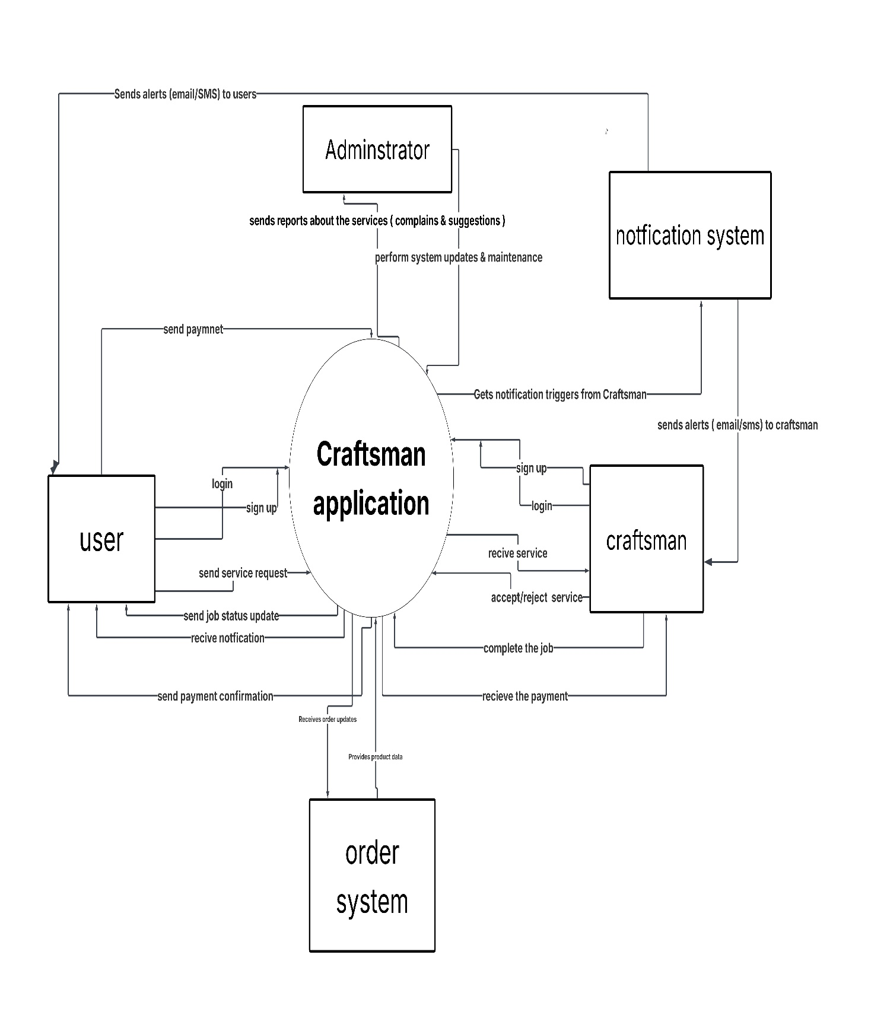

Slide 14
2- Use case

Slide 15
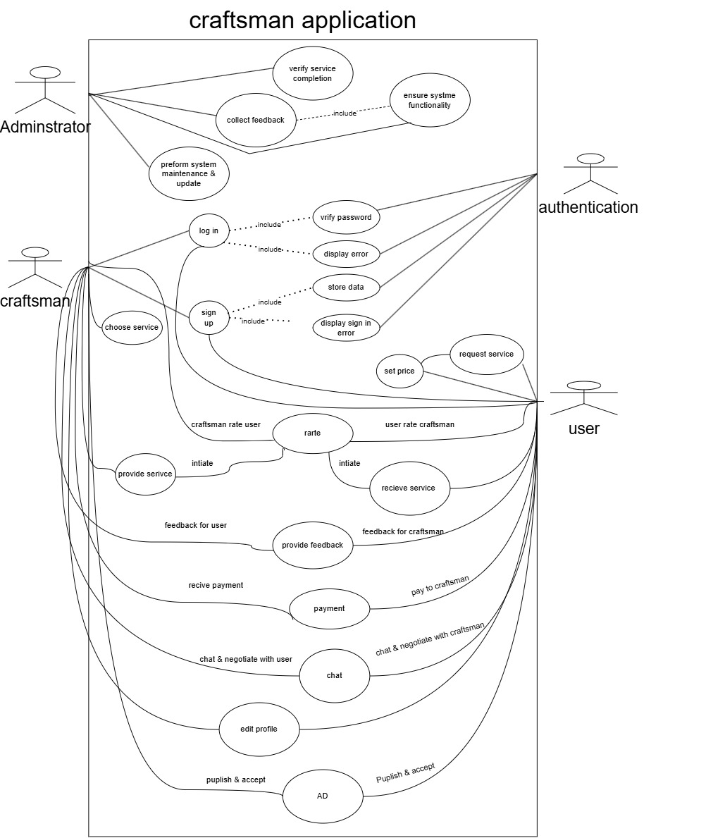

Slide 16
3- class diagram

Slide 17
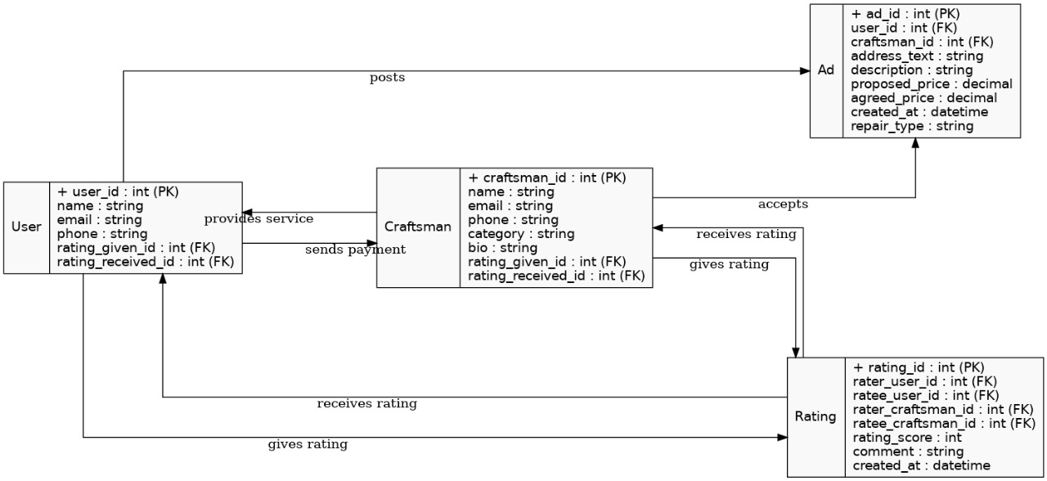

Slide 18
4-SEQUENCE DIAGRAM

Slide 19
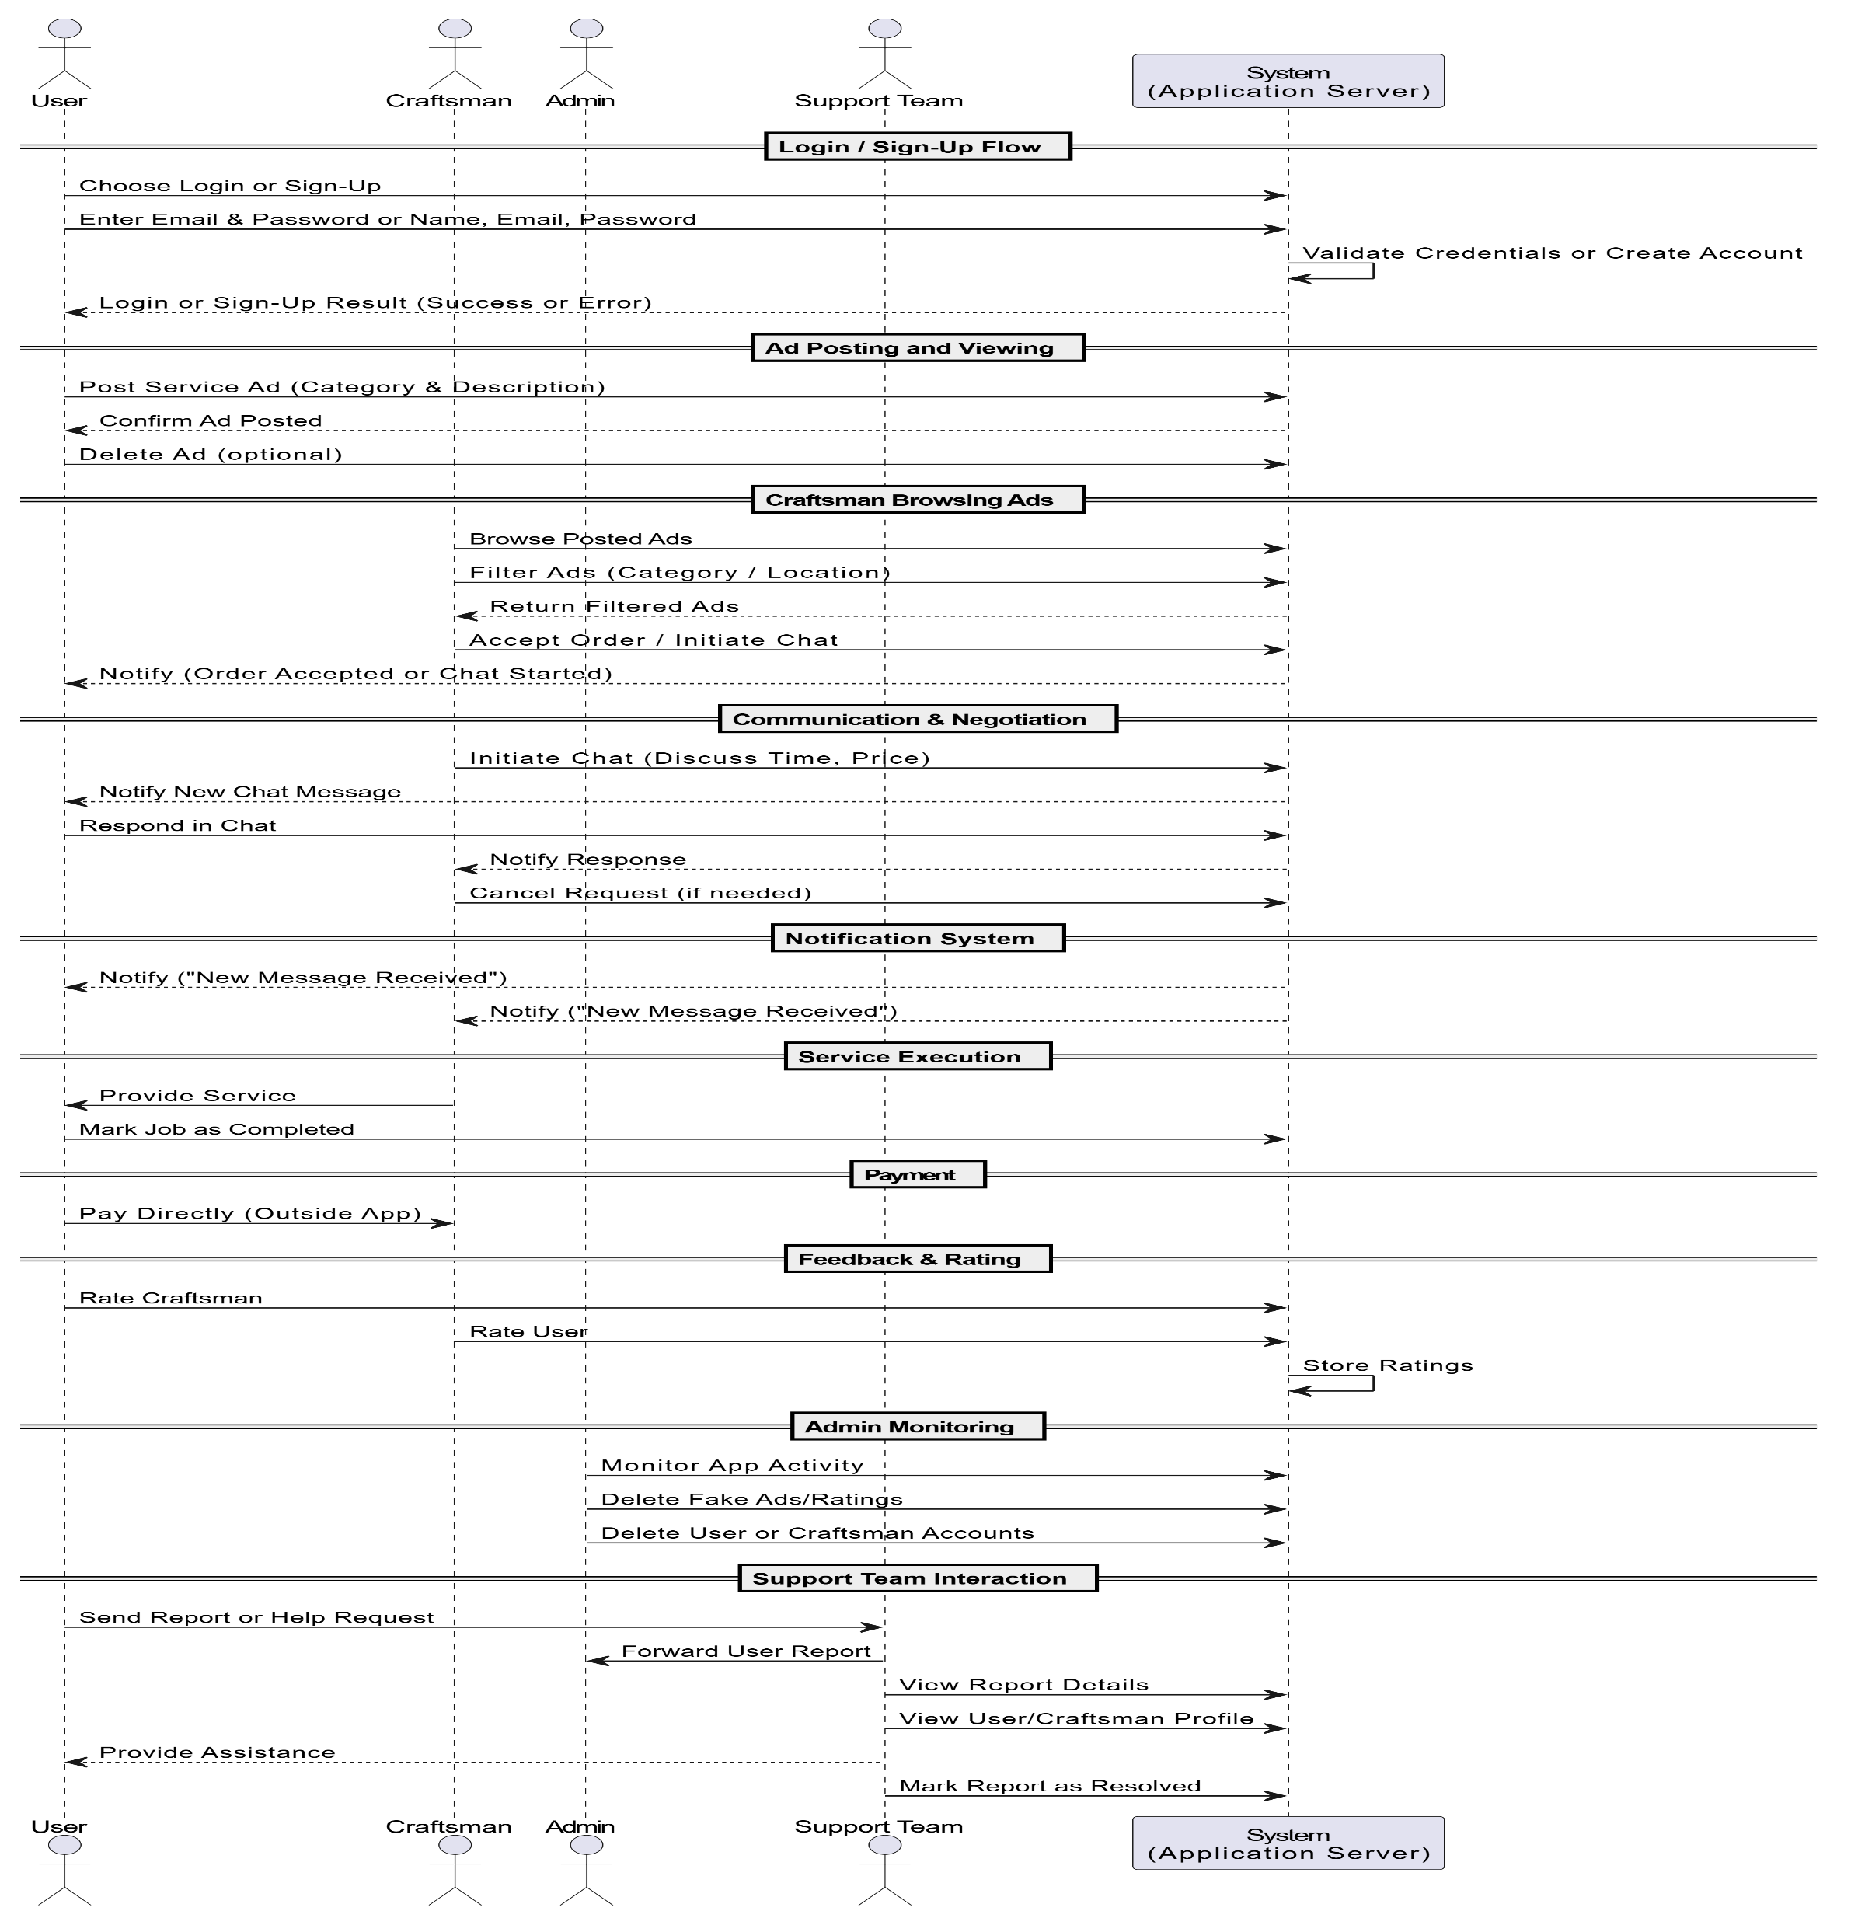

Slide 20
5-Activity Diagram

Slide 21
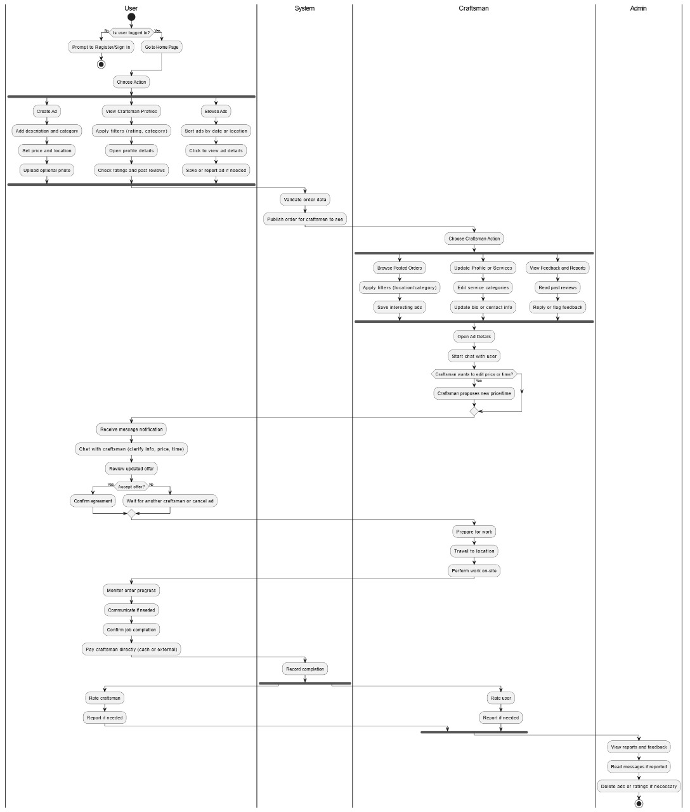

Slide 22
6-ERD

Slide 23
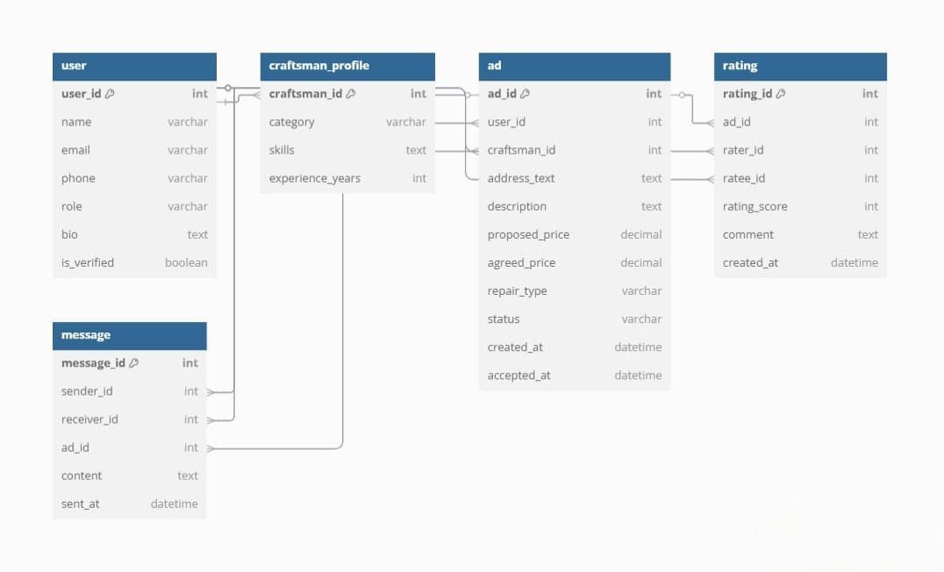

Slide 24
Screenshots from the application

Slide 25
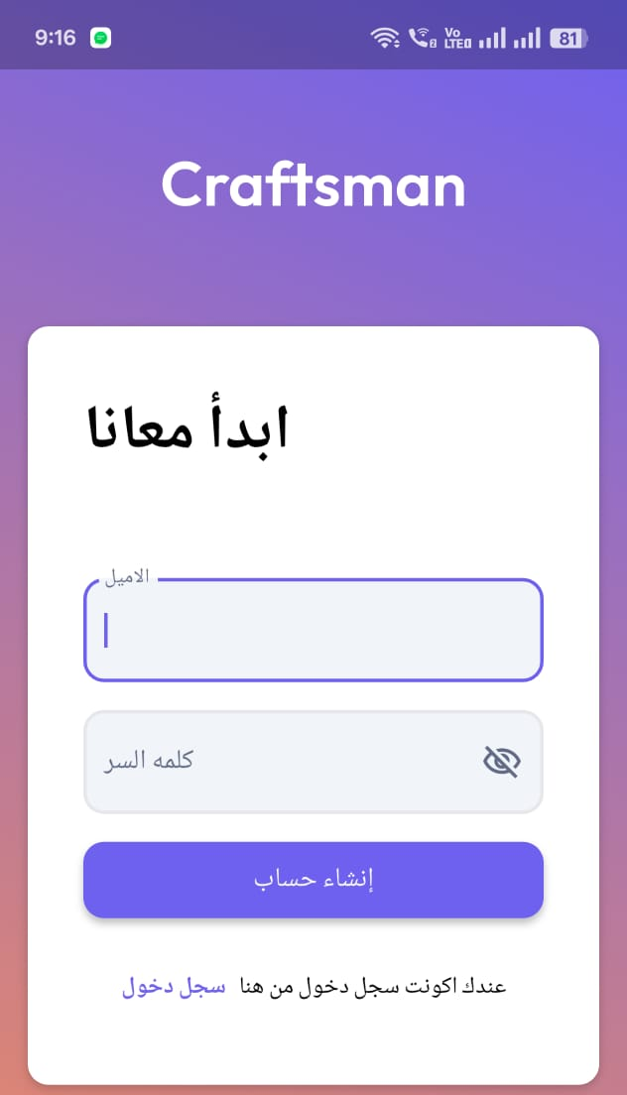
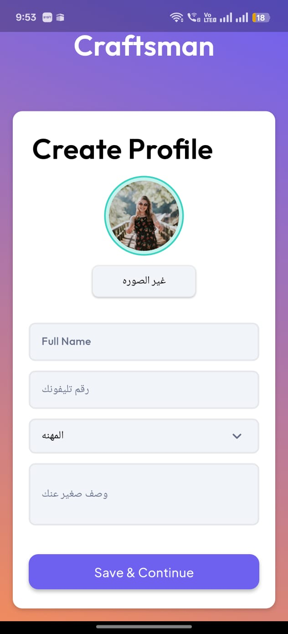
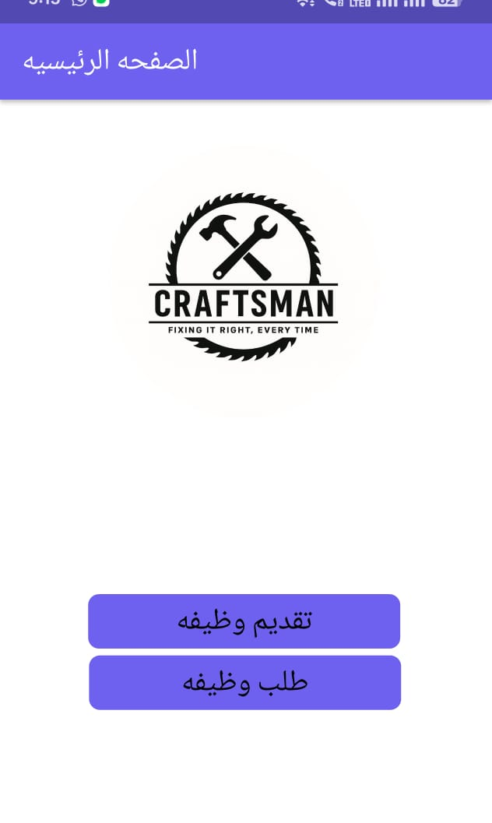

Slide 26
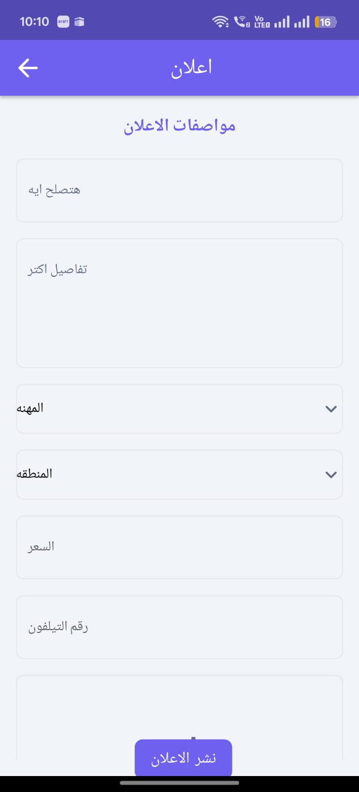
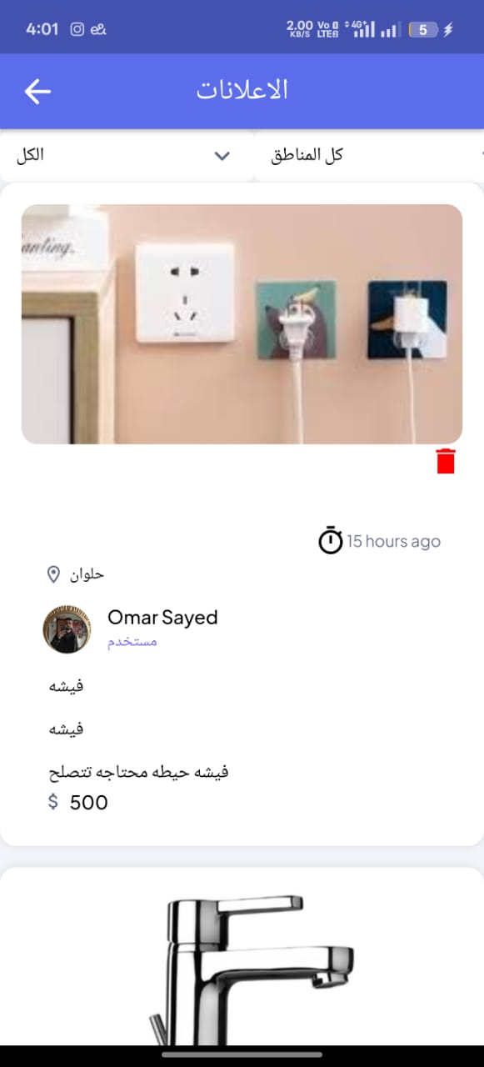
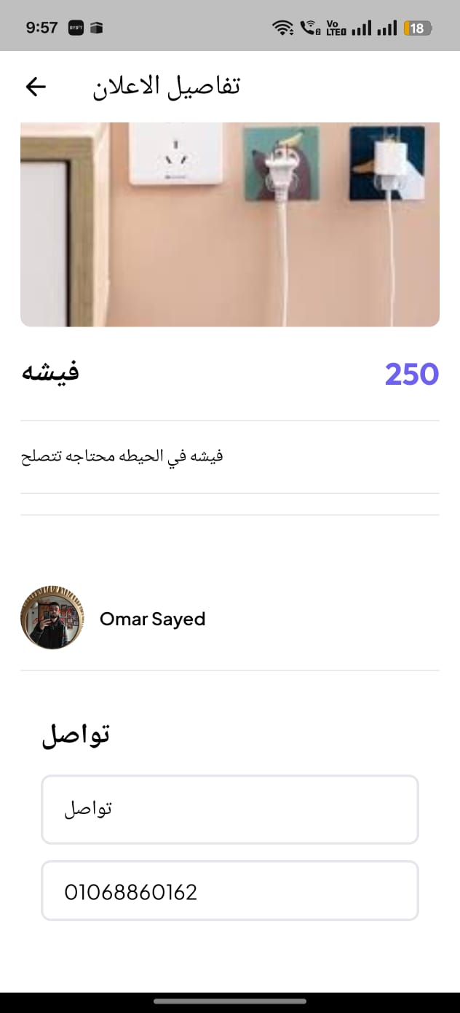

Slide 27
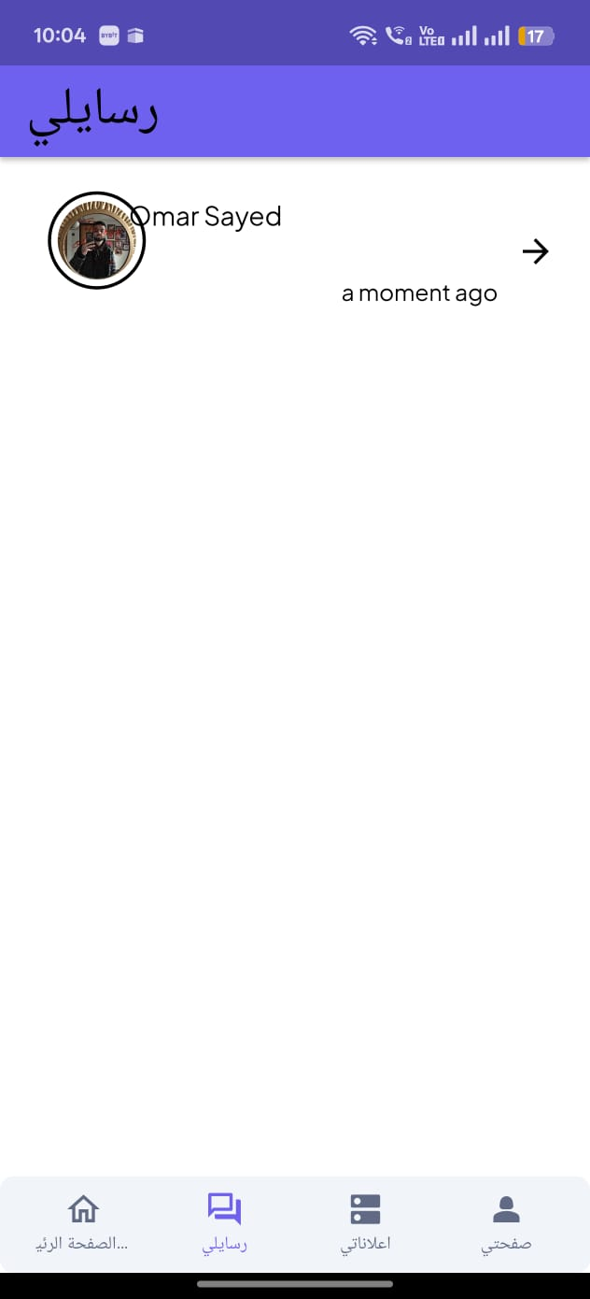
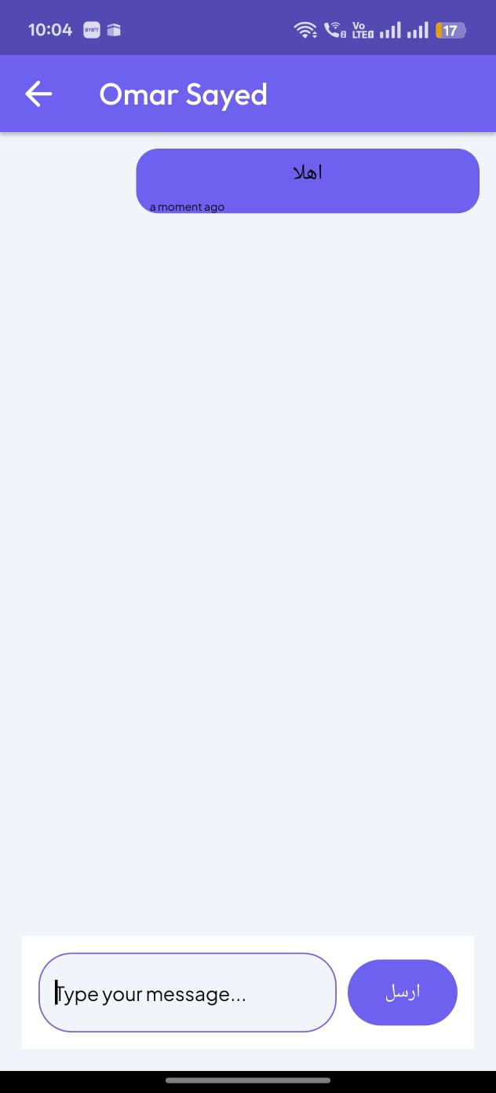

Slide 28


Tools

Slide 29
FlutterFlow: A low-code platform for building cross-platform mobile apps using Flutter. It offers drag-and-drop UI, animations, logic tools, and Firebase integration—ideal for quickly developing prototypes, MVPs, and production apps.
Firebase: A Backend-as-a-Service (BaaS) by Google that supports authentication, real-time databases, storage, cloud functions, and analytics. It enables fast, scalable, and secure backend development with seamless integration into Flutter and FlutterFlow.

Slide 30
Current Strategy & Future Plans

Slide 31
Current Strategy
Local Promotion: Share targeted posts in community groups where people live in the supported service areas.
Craftsman Bonus Program:
Offer rewards to craftsmen for completing a certain number of jobs per week.
Encourage craftsmen to invite others—bonuses are given only when the invited craftsman completes a job.
Digital Marketing: Launch Facebook Ads campaigns to increase awareness and attract both users and craftsmen.

Slide 32
future plan
Advanced Booking System: Add real-time scheduling with calendar sync, availability tracking, and auto-reminders.
In-App Promotions: Allow craftsmen to boost visibility with paid promotions and featured job listings.
Commission Model: Introduce subscriptions or small commissions once the app gains user trust and scale.
Emergency Requests: Enable urgent service requests for immediate help from nearby craftsmen.
Craftsman Analytics Dashboard: Provide insights on job history, ratings, earnings, and engagement to support business growth.

Slide 33
Conclusion
The Craftsman app offers a modern, practical solution to everyday home repair needs in Egypt. By connecting users with trusted craftsmen through a simple and transparent system, we aim to build a reliable platform that benefits both sides. Starting as a free service, our focus is on building trust, engagement, and real value. With future features like in-app booking and promotions, we’re not just solving a problem. we’re building the future of home services in egypt.

Slide 34
Thank
you

